Slide 1
General information for MATH 54
Lin Lin.林霖
https://math.berkeley.edu/~linlin/
Course website: Github
https://github.com/lin-lin/math54

Slide 2
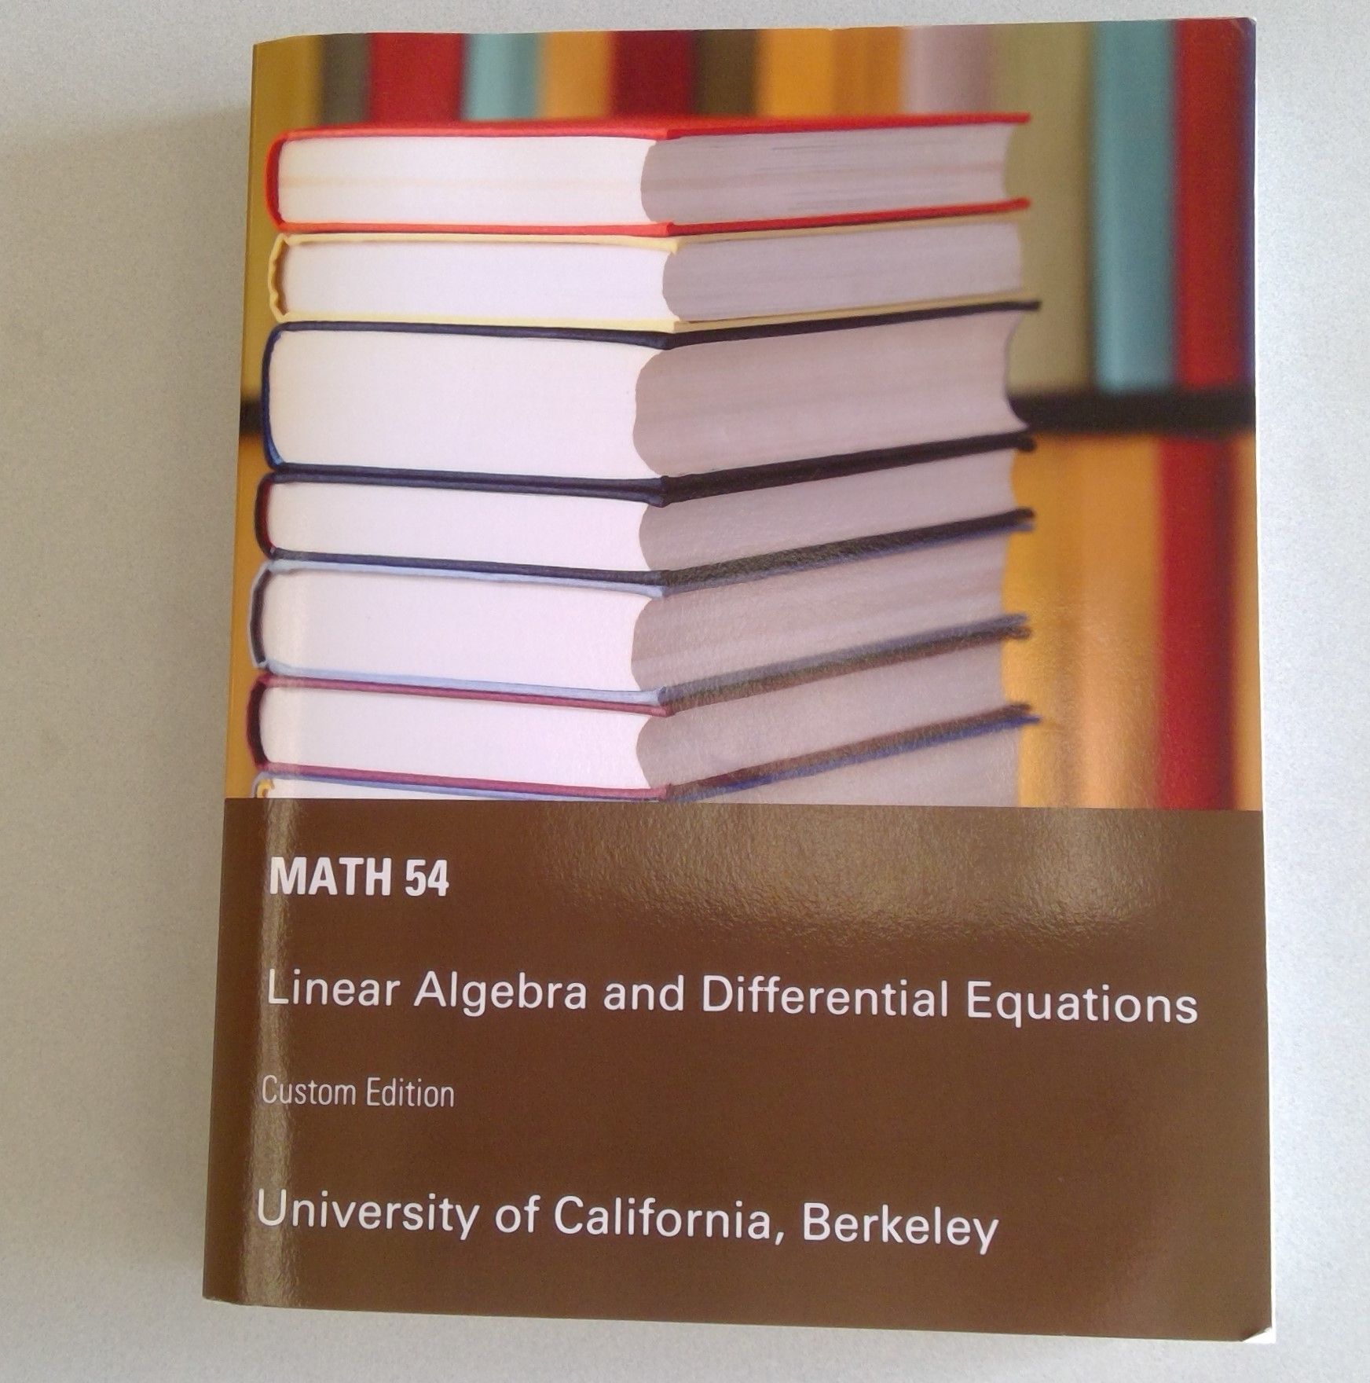
Two parts: Lay, Linear Algebra
Nagle-Saaf-Snider (NS&S), differential equation

Slide 3
Alternative textbooks:
Linear algebra and its applications, 5th edition by David C. Lay.
Fundamentals of differential equations, 9th edition by R. Kent Nagle, Edward B. Saff and Arthur David Snider.
Previous versions of the custom edition, or the separate textbooks as above may work, but it is your responsibility to make sure that you are doing the correct problem sets for your homework.

Slide 4
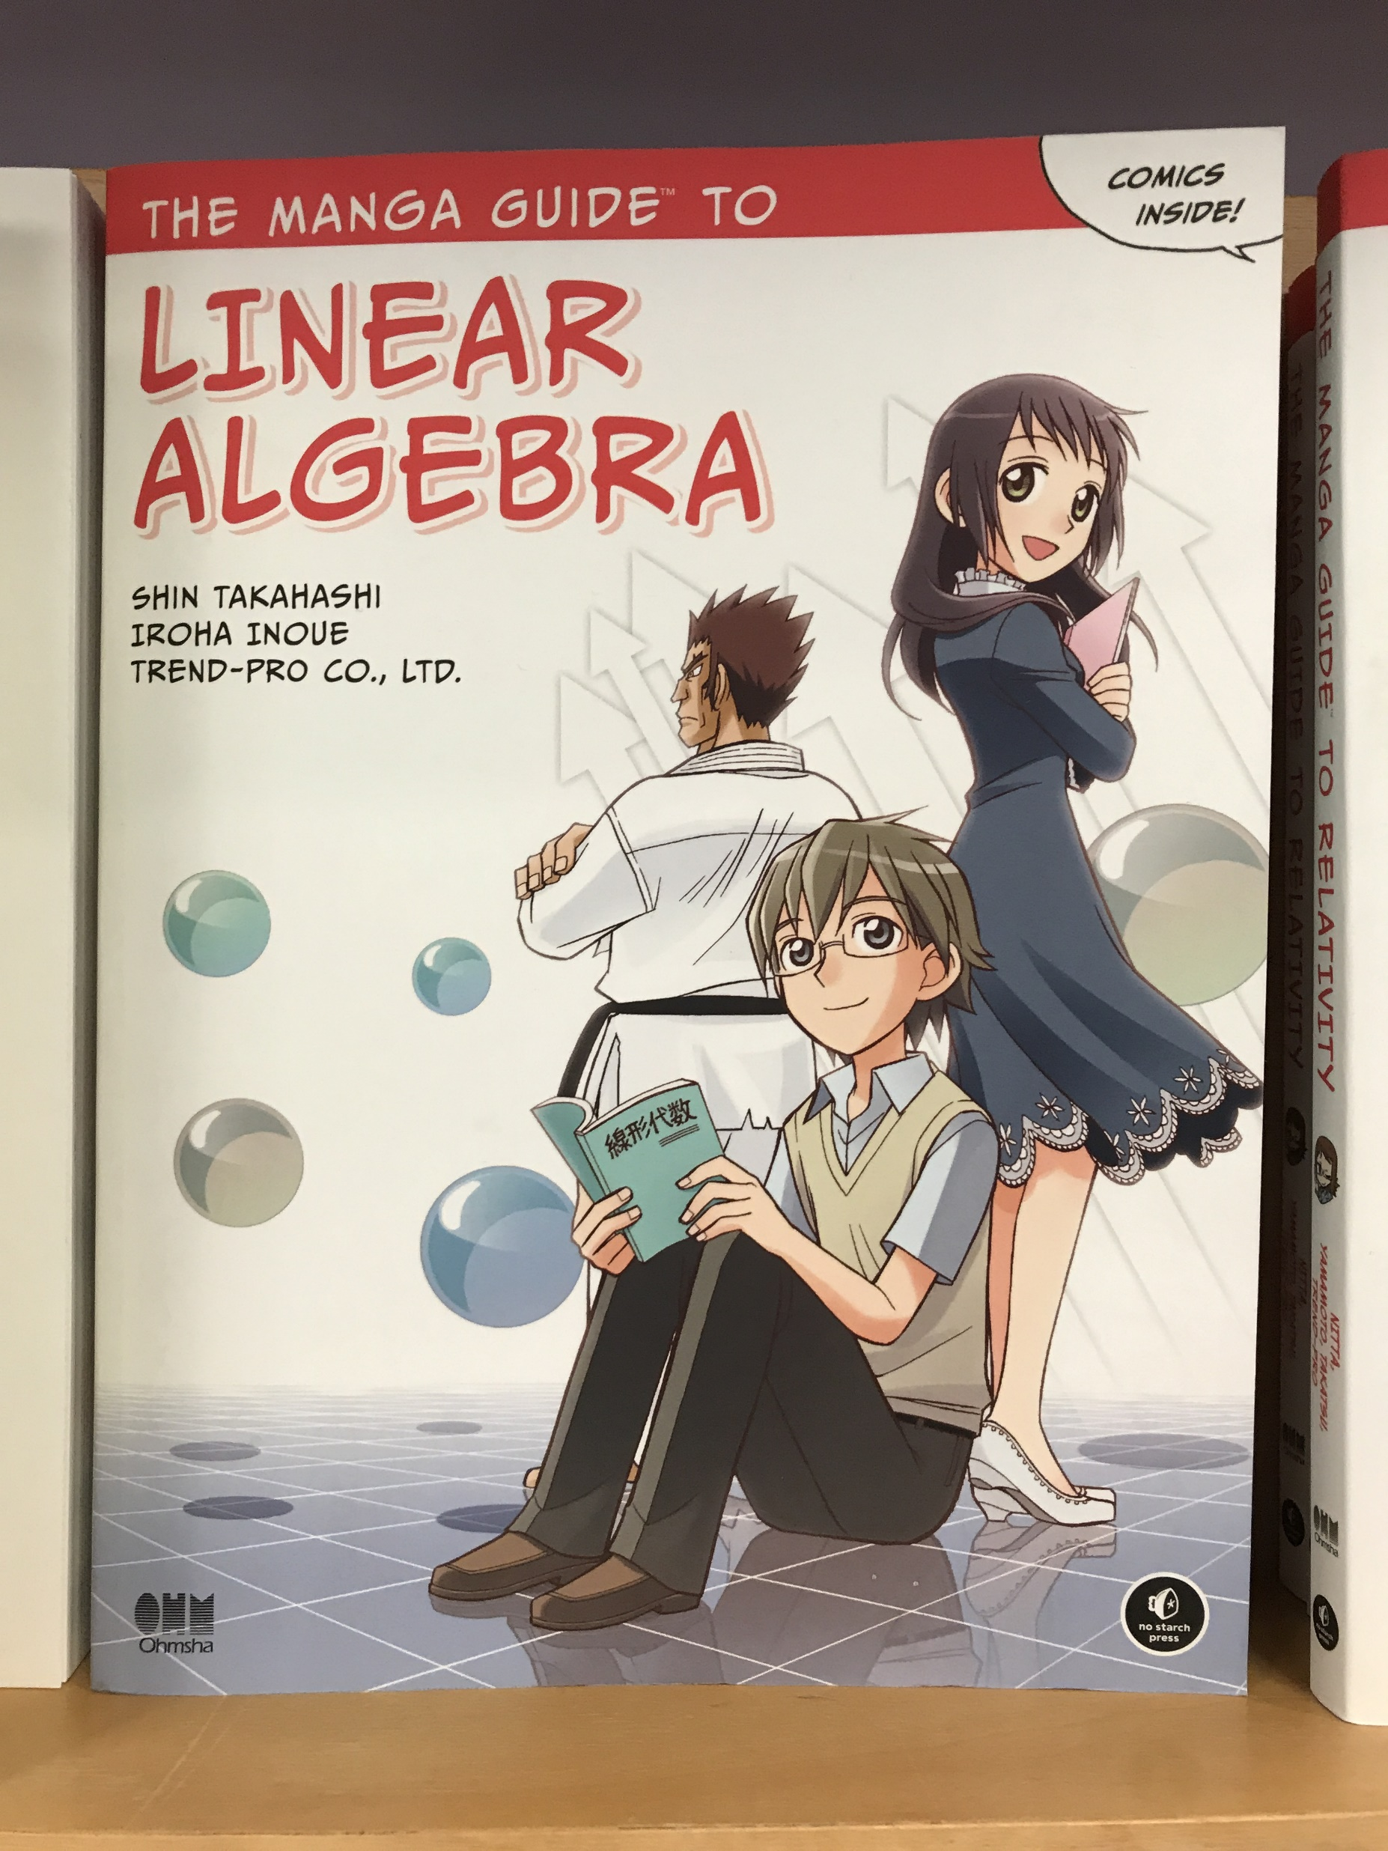
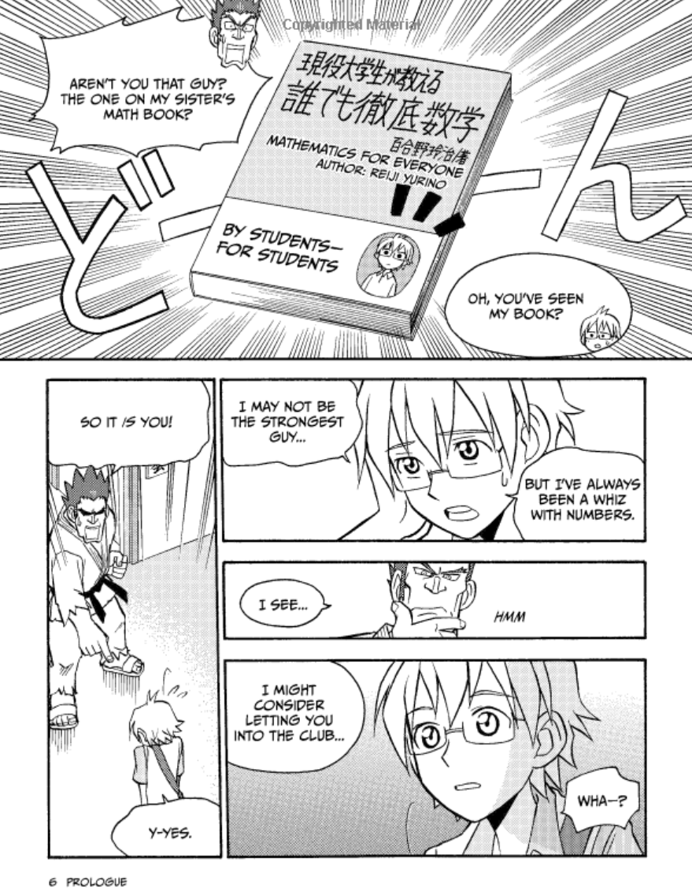
Not a valid alternative textbook: an example

Slide 5
Read the course policy very carefully.
Late submission = no credit.
No make-up exams.
DSP requests need to be made ASAP.

Slide 6
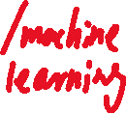

Slide 7
The power of abstraction
Vector Spaces, Linear Transformations. Continuous the discrete.
High dimension spaces. Dimension reduction.

